Slide 1

Normalization

Slide 2
What is Normalization?
Database designed based on the E-R model may have some amount of
Inconsistency
Uncertainty
Redundancy
To eliminate these draw backs some refinement has to be done on the database.
This Refinement process is called Normalization
Defined as a step-by-step process of decomposing a complex relation into a simple and stable data structure.
The formal process that can be followed to achieve a good database design
Also used to check that an existing design is of good quality
The different stages of normalization are known as “normal forms”
To accomplish normalization we need to understand the concept of Functional Dependencies.
‹#›

Slide 3
Functional dependency
In a given relation R, X and Y are attributes. Attribute Y is functionally dependent on attribute X if each value of X determines EXACTLY ONE value of Y, which is represented as X -> Y (X can be composite in nature).
We say here “x determines y” or “y is functionally dependent on x”
X→Y does not imply Y→X
If the value of an attribute “Marks” is known then the value of an attribute “Grade” is determined since Marks→ Grade
Types of functional dependencies:
Full Functional dependency
Partial Functional dependency
Transitive dependency
‹#›

Slide 4
Functional Dependencies
Consider the following Relation
REPORT (STUDENT#,COURSE#, CourseName, IName, Room#, Marks, Grade)
STUDENT# - Student Number
COURSE# - Course Number
CourseName - Course Name
IName - Name of the Instructor who delivered the course
Room# - Room number which is assigned to respective Instructor
Marks - Scored in Course COURSE# by Student STUDENT#
Grade - obtained by Student STUDENT# in Course COURSE#
‹#›

Slide 5
Functional Dependencies- From the previous example
STUDENT# COURSE# 🡪 Marks
COURSE# 🡪 CourseName,
COURSE# 🡪 IName (Assuming one course is taught by one and only one Instructor)
IName 🡪 Room# (Assuming each Instructor has his/her own and non-shared room)
Marks 🡪 Grade
‹#›

Slide 6
Dependency diagram
Report( S#,C#,SName,CTitle,IName,Room#,Marks,Grade)
S# 🡪 SName
C# 🡪 CTitle,
C# 🡪 IName
IName 🡪 Room#
C# 🡪 Room#
S# C# 🡪 Marks
Marks 🡪 Grade
S# C# 🡪 Grade
S#
C#
CTitle
SName
IName
Marks
Grade
Room#
Assumptions:
Each course has only one Instructor and each Instructor has a room.
Grade is determined from Marks
‹#›

Slide 7
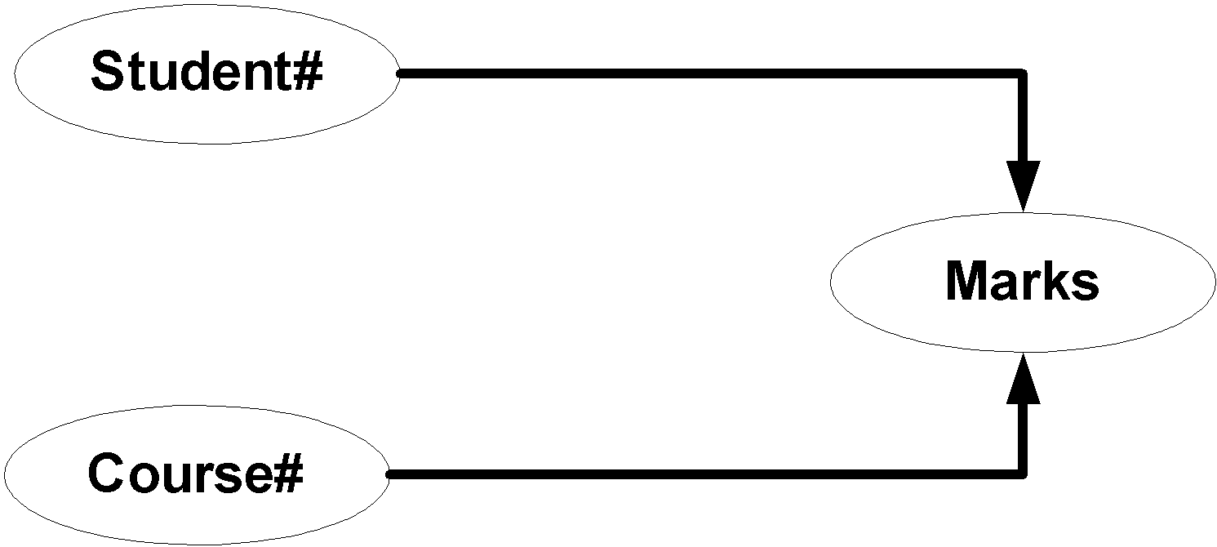
Full dependencies
X and Y are attributes.
X Functionally determines Y
Note: Subset of X should not functionally determine Y
‹#›

Slide 8
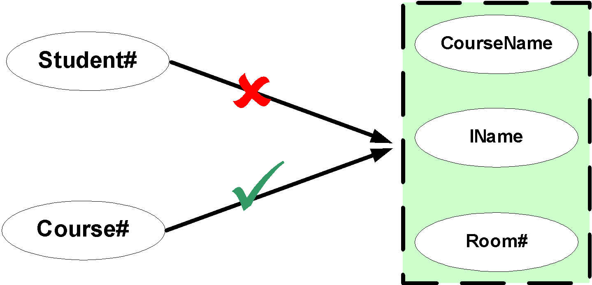
Partial dependencies
X and Y are attributes.
Attribute Y is partially dependent on the attribute X only if it is dependent on a sub-set of attribute X.
‹#›

Slide 9

Transitive dependencies
X Y and Z are three attributes.
X -> Y
Y-> Z
=> X -> Z
‹#›

Slide 10
Need for Normalization Student_Course_Result Table
Student_Details |  |  | Course_Details |  |  |  |  | Result_Details
101 | Davis | 11/4/1986 | M4 | Applied Mathematics | Basic Mathematics |  | 7 | 11/11/2004 | 82 | A
102 | Daniel | 11/6/1987 | M4 | Applied Mathematics | Basic Mathematics |  | 7 | 11/11/2004 | 62 | C
101 | Davis | 11/4/1986 | H6 | American History |  |  | 4 | 11/22/2004 | 79 | B
103 | Sandra | 10/2/1988 | C3 | Bio Chemistry |  | Basic Chemistry | 11 | 11/16/2004 | 65 | B
104 | Evelyn | 2/22/1986 | B3 | Botany |  |  | 8 | 11/26/2004 | 77 | B
102 | Daniel | 11/6/1987 | P3 | Nuclear Physics |  | Basic Physics | 13 | 11/12/2004 | 68 | B
105 | Susan | 8/31/1985 | P3 | Nuclear Physics |  | Basic Physics | 13 | 11/12/2004 | 89 | A
103 | Sandra | 10/2/1988 | B4 | Zoology |  |  | 5 | 11/27/2004 | 54 | D
105 | Susan | 8/31/1985 | H6 | American History |  |  | 4 | 11/22/2004 | 87 | A
104 | Evelyn | 2/22/1986 | M4 | Applied Mathematics | Basic Mathematics |  | 7 | 11/11/2004 | 65 | B
Insert , Delete, Update Anomaly and Data Duplication
‹#›

Slide 11
First Normal Form: 1NF
A relation schema is in 1NF :
if and only if all the attributes of the relation R are atomic in nature.
Atomic: the smallest level to which data may be broken down and remain meaningful
‹#›

Slide 12
Student_Course_Result Table
Student_Details |  |  | Course_Details |  |  |  | Results
101 | Davis | 11/4/1986 | M4 | Applied Mathematics | Basic Mathematics | 7 | 11/11/2004 | 82 | A
102 | Daniel | 11/6/1987 | M4 | Applied Mathematics | Basic Mathematics | 7 | 11/11/2004 | 62 | C
101 | Davis | 11/4/1986 | H6 | American History |  | 4 | 11/22/2004 | 79 | B
103 | Sandra | 10/2/1988 | C3 | Bio Chemistry | Basic Chemistry | 11 | 11/16/2004 | 65 | B
104 | Evelyn | 2/22/1986 | B3 | Botany |  | 8 | 11/26/2004 | 77 | B
102 | Daniel | 11/6/1987 | P3 | Nuclear Physics | Basic Physics | 13 | 11/12/2004 | 68 | B
105 | Susan | 8/31/1985 | P3 | Nuclear Physics | Basic Physics | 13 | 11/12/2004 | 89 | A
103 | Sandra | 10/2/1988 | B4 | Zoology |  | 5 | 11/27/2004 | 54 | D
105 | Susan | 8/31/1985 | H6 | American History |  | 4 | 11/22/2004 | 87 | A
104 | Evelyn | 2/22/1986 | M4 | Applied Mathematics | Basic Mathematics | 7 | 11/11/2004 | 65 | B
‹#›

Slide 13
Table in 1NF
Student_Course_Result Table in First Normal Form
‹#›

Slide 14
Second Normal Form: 2NF
A Relation is said to be in Second Normal Form if and only if :
It is in the First normal form, and
No partial dependency exists between non-key attributes and key attributes.
An attribute of a relation R that belongs to the candidate key of R is said to be a key attribute and that which doesn’t is a non-key attribute
To make a table 2NF compliant, we have to remove all the partial dependencies
Note : - All partial dependencies are eliminated
‹#›

Slide 15
Key and Non-Key Attributes
Student_Course_Result(Student#, Course#, StudentName, DateOfBirth, CourseName, PreRequisite, DurationInDays, DateOfExam, Marks, Grade)
Student#
Is a KEY Attribute
Course#
StudentName
DateOfBirth
CourseName
PreRequisite
Is NON-KEY Attribute
Marks
Grade
DurationInDays
DateOfExam
‹#›

Slide 16
Second Normal Form
STUDENT# is key attribute for Student
COURSE# is key attribute for Course
STUDENT# COURSE# together form the composite key attributes for Student_Course_Result relation.
Other attributes like StudentName (Student Name), DateOfBirth, CourseName, PreRequisite, DurationInDays, DateOfExam, Marks and Grade are non-key attributes.
To make this table 2NF compliant, we have to remove all the partial
Dependencies.
Student #, Course# -> Marks, Grade
Student# -> StudentName, DateOfBirth,
Course# -> CourseName, PreRequisite, DurationInDays, DateOfExam
‹#›

Slide 17
Second Normal Form
Fully Functionally dependent on composite Primary key
S#,C#
Marks
S#,C#
Grade
S#
StudentName
Partial Dependency with respect to the Primary Key
S#
DOB
C#
CourseName
C#
Prerequisite
Partial Dependency with respect to the Primary Key
C#
Duration
C#
DateOfExam
‹#›

Slide 18
Second Normal Form - Tables in 2 NF
COURSE TABLE
Course# | Course Name | Pre Requisite | Duration | Date Of Exam
M1 | Basic Mathematics |  | 11 | 11-Nov-04
M4 | Applied Mathematics | M1 | 7 | 11-Nov-04
H6 | American History |  | 4 | 22-Nov-04
C1 | Basic Chemistry |  | 5 | 16-Nov-04
C3 | Bio Chemistry | C1 | 11 | 16-Nov-04
B3 | Botany |  | 8 | 26-Nov-04
P1 | Basic Physics |  | 8 | 12-Nov-04
P3 | Nuclear Physics | P1 | 13 | 12-Nov-04
B4 | Zoology |  | 5 | 27-Nov-04
STUDENT TABLE
Student# | StudentName | DateofBirth
101 | Davis | 04-Nov-1986
102 | Daniel | 06-Nov-1987
103 | Sandra | 02-Oct-1988
104 | Evelyn | 22-Feb-1986
105 | Susan | 31-Aug-1985
106 | Mike | 04-Feb-1987
107 | Juliet | 09-Nov-1986
108 | Tom | 07-Oct-1986
109 | Catherine | 06-Jun-1984
‹#›

Slide 19
Second Normal form – Tables in 2 NF
Report
Student# | Course# | Marks | Grade
101 | M4 | 82 | A
102 | M4 | 62 | C
101 | H6 | 79 | B
103 | C3 | 65 | B
104 | B3 | 77 | B
102 | P3 | 68 | B
105 | P3 | 89 | A
103 | B4 | 54 | D
105 | H6 | 87 | A
104 | M4 | 65 | B
‹#›

Slide 20
Second Normal Form - Tables in 2 NF
COURSE TABLE
Course# | Course Name | Pre Requisite | Duration InDays
M1 | Basic Mathematics |  | 11
M4 | Applied Mathematics | M1 | 7
H6 | American History |  | 4
C1 | Basic Chemistry |  | 5
C3 | Bio Chemistry | C1 | 11
B3 | Botany |  | 8
P1 | Basic Physics |  | 8
P3 | Nuclear Physics | P1 | 13
B4 | Zoology |  | 5
STUDENT TABLE
Student# | StudentName | DateofBirth
101 | Davis | 04-Nov-1986
102 | Daniel | 06-Nov-1987
103 | Sandra | 02-Oct-1988
104 | Evelyn | 22-Feb-1986
105 | Susan | 31-Aug-1985
106 | Mike | 04-Feb-1987
107 | Juliet | 09-Nov-1986
108 | Tom | 07-Oct-1986
109 | Catherine | 06-Jun-1984
‹#›

Slide 21
Second Normal form – Tables in 2 NF
Report
Student# | Course# | Marks | Grade
101 | M4 | 82 | A
102 | M4 | 62 | C
101 | H6 | 79 | B
103 | C3 | 65 | B
104 | B3 | 77 | B
102 | P3 | 68 | B
105 | P3 | 89 | A
103 | B4 | 54 | D
105 | H6 | 87 | A
104 | M4 | 65 | B
‹#›

Slide 22
Second Normal form – Tables in 2 NF
Exam_Date Table
Course# | DateOfExam
M4 | 11-Nov-04
H6 | 22-Nov-04
C3 | 16-Nov-04
B3 | 26-Nov-04
P3 | 12-Nov-04
B4 | 27-Nov-04
‹#›

Slide 23
Third Normal Form: 3 NF
A relation R is said to be in the Third Normal Form (3NF) if and only if
It is in 2NF and
No transitive dependency exists between non-key attributes and key attributes.
S#,C#
Marks
In Report Table STUDENT# and COURSE#
are the key attributes.
All other attributes, except grade are non-partially, non-transitively dependent on key attributes.
Student#, Course# - > Marks
Marks -> Grade
S#,C#
Grade
S#,C#
Marks
Grade
Note : - All transitive dependencies are eliminated
‹#›

Slide 24
3NF Tables
Marks
Student# | Course# | Marks
101 | M4 | 82
102 | M4 | 62
101 | H6 | 79
103 | C3 | 65
104 | B3 | 77
102 | P3 | 68
105 | P3 | 89
103 | B4 | 54
105 | H6 | 87
104 | M4 | 65
‹#›

Slide 25
Third Normal Form – Tables in 3 NF
MarksGrade
Marks | Grade
82 | A
62 | C
79 | B
65 | B
77 | B
68 | B
89 | A
54 | D
87 | A
65 | B
‹#›

Slide 26
Third Normal Form – Tables in 3 NF
GRADE TABLE
UpperBound | LowerBound | Grade
100 | 95 | A+
94 | 85 | A
84 | 70 | B
69 | 65 | B-
64 | 55 | C
54 | 45 | D
44 | 0 | E
‹#›

Slide 27
Boyce-Codd Normal Form - BCNF
A relation is said to be in Boyce Codd Normal Form (BCNF)
- if and only if all the determinants are candidate keys.
BCNF relation is a strong 3NF, but not every 3NF relation is BCNF.
‹#›

Slide 28
Consider this Result Table
Result
Student# | EmailID | Course# | Marks
101 | Davis@myuni.edu | M4 | 82
102 | Daniel@myuni.edu | M4 | 62
101 | Davis@myuni.edu | H6 | 79
103 | Sandra@myuni.edu | C3 | 65
104 | Evelyn@myuni.edu | B3 | 77
102 | Daniel@myuni.edu | P3 | 68
105 | Susan@myuni.edu | P3 | 89
103 | Sandra@myuni.edu | B4 | 54
105 | Susan@myuni.edu | H6 | 87
104 | Evelyn@myuni.edu | M4 | 65
‹#›

Slide 29
BCNF
Candidate Keys for the relation are:
S#
C#
and
C#
EmailID
Since Course# is overlapping, it is referred as Overlapping Candidate Key.
S#
C#
C#
C#
EmailID
Valid Functional Dependendencies are
S#
EMailID
( Non Key Determinant )
EMailID
S#
( Non Key Determinant )
S#,C#
Marks
C#,EMailID
Marks
‹#›

Slide 30
BCNF Tables
STUDENT TABLE
Student# | EmailID
101 | Davis@myuni.edu
102 | Daniel@myuni.edu
103 | Sandra@myuni.edu
104 | Evelyn@myuni.edu
105 | Susan@myuni.edu
‹#›

Slide 31
BCNF Tables
Marks
Student# | Course# | Marks
101 | M4 | 82
102 | M4 | 62
101 | H6 | 79
103 | C3 | 65
104 | B3 | 77
102 | P3 | 68
105 | P3 | 89
103 | B4 | 54
105 | H6 | 87
104 | M4 | 65
‹#›

Slide 32
Merits of Normalization
Normalization is based on a mathematical foundation.
Removes the redundancy to a greater extent.
After 3NF, data redundancy is minimized to the extent of foreign keys.
Removes the anomalies present in INSERTs, UPDATEs and DELETEs.
‹#›

Slide 33
Demerits of Normalization
Data retrieval or SELECT operation performance will be severely affected.
Normalization might not always represent real world scenarios.
‹#›

Slide 34
Summary of Normal Forms
Input | Operation | Output
Un-normalized Table | Create separate rows or columns for every combination of multivalued columns | Table in 1 NF
Table in 1 NF | Eliminate Partial dependencies | Tables in 2NF
Tables in 2 NF | Eliminate Transitive dependencies | Tables in 3 NF
Tables in 3 NF | Eliminate Overlapping candidate key columns | Tables in BCNF
‹#›

Slide 35
Summary
Normalization is a refinement process. It helps in removing anomalies present in INSERTs/UPDATEs/DELETEs.
Normalization is also called “Bottom-up approach”, because this technique requires very minute details like every participating attribute and how it is dependant on the key attributes, is crucial. If you add new attributes after normalization, it may change the normal form itself.
There are four normal forms that were defined being commonly used.
1NF makes sure that all the attributes are atomic in nature.
2NF removes the partial dependency.
‹#›

Slide 36
Summary – contd.
3NF removes the transitive dependency.
BCNF removes dependency among key attributes.
Too much of normalization adversely affects SELECT or RETRIEVAL operations.
It is always better to normalize to 3NF for INSERT, UPDATE and DELETE intensive (On-line transaction) systems.
It is always better to restrict to 2NF for SELECT intensive (Reporting) systems.
While normalizing, use common sense and don’t use the normal forms as absolute measures.
‹#›

